Slide 1
Introduction to GR6130
Chris Baldassano
Agnes Chang

Slide 2
Goals of the course
Learn about new tools for constructing and sharing reproducible analyses
Brainstorming through in-class discussions about which of these tools are useful to you
Hands-on learning with these tools
Applying tools to a real research question in the final project

Slide 3
Structure of the course
Each class session will consist of:
~1 hour of lecture/discussion
What is the purpose of this tool or set of tools?
How can we use it?
How should we use it, as psychology/neuroscience researchers?
~45 minutes of hands-on practice with the tool(s)
Instructor will randomly split the class into small groups of 3-4 students
Groups should work together to complete the lab, but each student should also individually submit a complete version through git

Slide 4
Final Project
Use some of the tools from the class to construct and share a reproducible manuscript for an analysis of your choice (using your own data or publicly-available data)
Should allow anyone to easily produce a pdf report with analysis results, visualizations, and text, directly from the raw data
Projects will be presented during the final class session
Project proposal due 9/20/19

Slide 5
Grading
25% Attendance and participation
Read assigned readings ahead of time, and contribute to class discussions
Email me before class if you will be unable to attend (aside from emergencies)
15% In-class lab tutorials
Complete and submit each tutorial – these are intended to be done during class time, but can also be finished afterwards if necessary
60% Final project
10% Project proposal 9/20/19
10% Interim report 10/25/19
30% Final report 12/6/19
10% Presentation 12/6/19

Slide 6
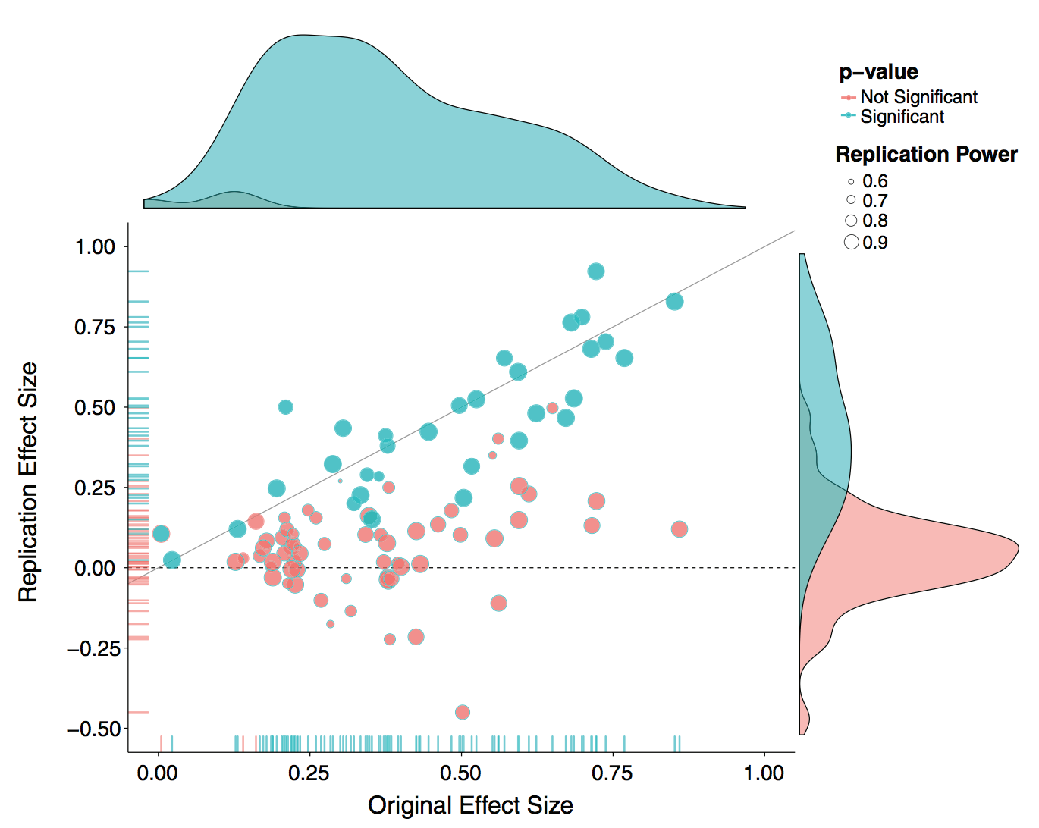
The winds of change
Psychology is in the midst of an upheaval over how science should be conducted and reported
Replication – after publishing a result, can a separate group of scientists collect a new dataset and obtain the same result?
Open Science Collaboration. (2015). Estimating the reproducibility of psychological science. Science, 349(6251), aac4716.

Slide 7
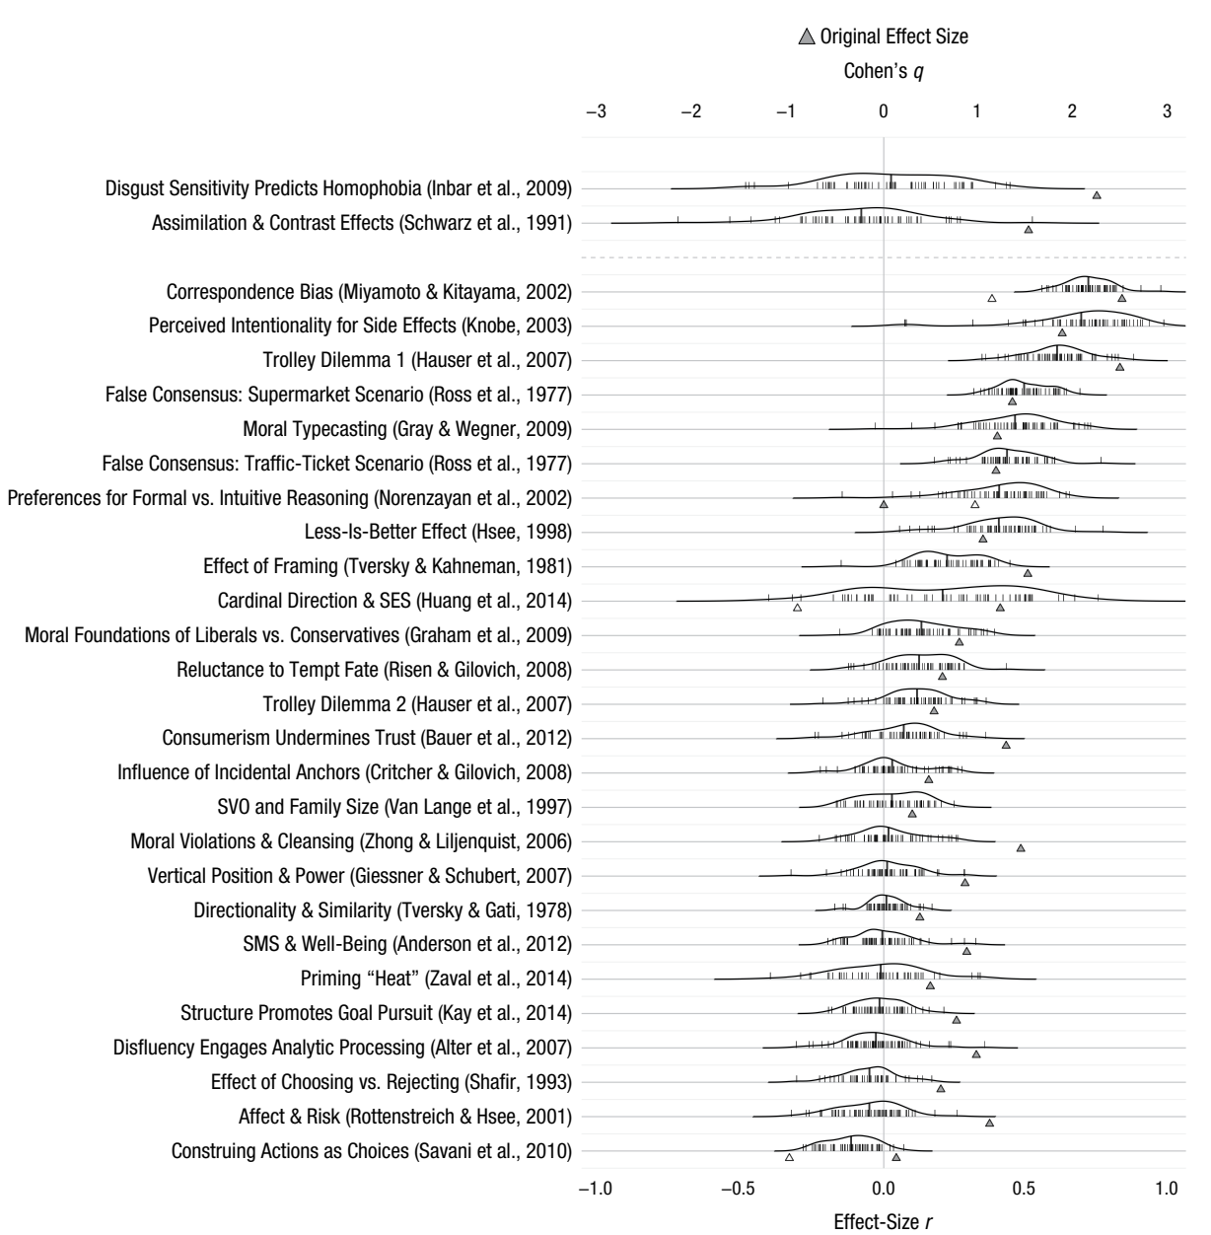
Klein, et al. (2018). Many Labs 2: Investigating variation in replicability across samples and settings. Advances in Methods and Practices in Psychological Science, 1(4), 443-490.

Slide 8
Reproducibility
A related, but more basic idea: reproducibility
Can another group of scientists get the same result, using the same exact dataset?
Why aren’t journal articles enough?
“The Materials and Methods should provide enough detail for reproduction of the findings”
Infeasible/impossible to fully specify an analysis in English in a couple pages
Recreating an analysis pipeline takes enormous work, and could be impossible if critical software is deprecated/licensed

Slide 9
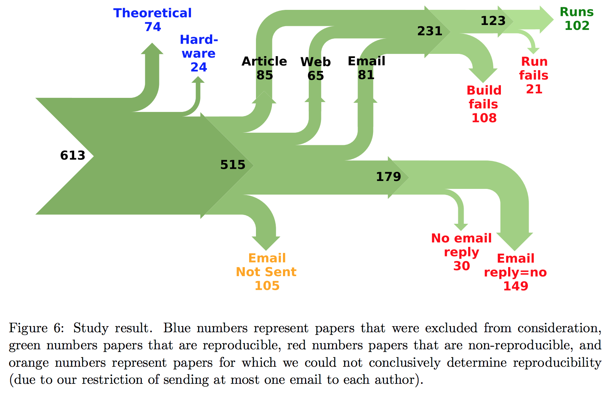
Moraila, G., Shankaran, A., Shi, Z., & Warren, A. M. (2014). Measuring reproducibility in computer systems research.

Slide 10
Why value reproducibility?
Ensures results can be validly produced from raw data alone
Allows inspection of all analysis choices/parameters, and for testing whether the results are sensitive to each of them
Analysis can be easily re-run in the short-term or long-term, for example if the dataset changes or is corrected
Pipeline can be easily applied to other datasets or new datasets, for comparison

Slide 11
Reproducibility: An old idea?
Jon Claerbout and Martin Karrenbach 1992 meeting of the Society of Exploration Geophysics
“In 1990, we set this sequence of goals:
Learn how to merge a publication with its underlying computational analysis.
Teach researchers how to prepare a document in a form where they themselves can reproduce their own research results a year or more later by “pressing a single button”.
Learn how to leave finished work in a condition where coworkers can reproduce the calculation including the final illustration by pressing a button in its caption.

Slide 12
Reproducibility: An old idea?
Prepare a complete copy of our local software environment so that graduating students can take their work away with them to other sites, press a button, and reproduce their Stanford work.
Merge electronic documents written by multiple authors (SEP reports).
Export electronic documents to numerous other sites (sponsors) so they can readily reproduce a substantial portion of our Stanford research.”

Slide 13
Reproducibility: An old idea?
Even older: Robert Boyle, 1665
“In Boyle's view the capacity of experiments to yield matters of fact depended not only upon their actual performance but essentially upon the assurance of the relevant community that they had been so performed.”
Steven Shapin and Simon Schaffer, Leviathan and the Air-Pump: Hobbes, Boyle and the Experimental Life, Princeton; Princeton University Press, 1985, Chapter 2, pp. 22-79.

Slide 14
Changes in publication
Historically, the end result of a scientific project is a static article (pages of text and graphics) published through anonymous peer-review in a subscription-based journal
All parts of this sentence are currently being challenged
UC libraries break with Elsevier
Preprint servers
Post-publication review, open review, signed review
Let’s focus on the “static text/graphics” part – is this the right way to communicate science?

Slide 15
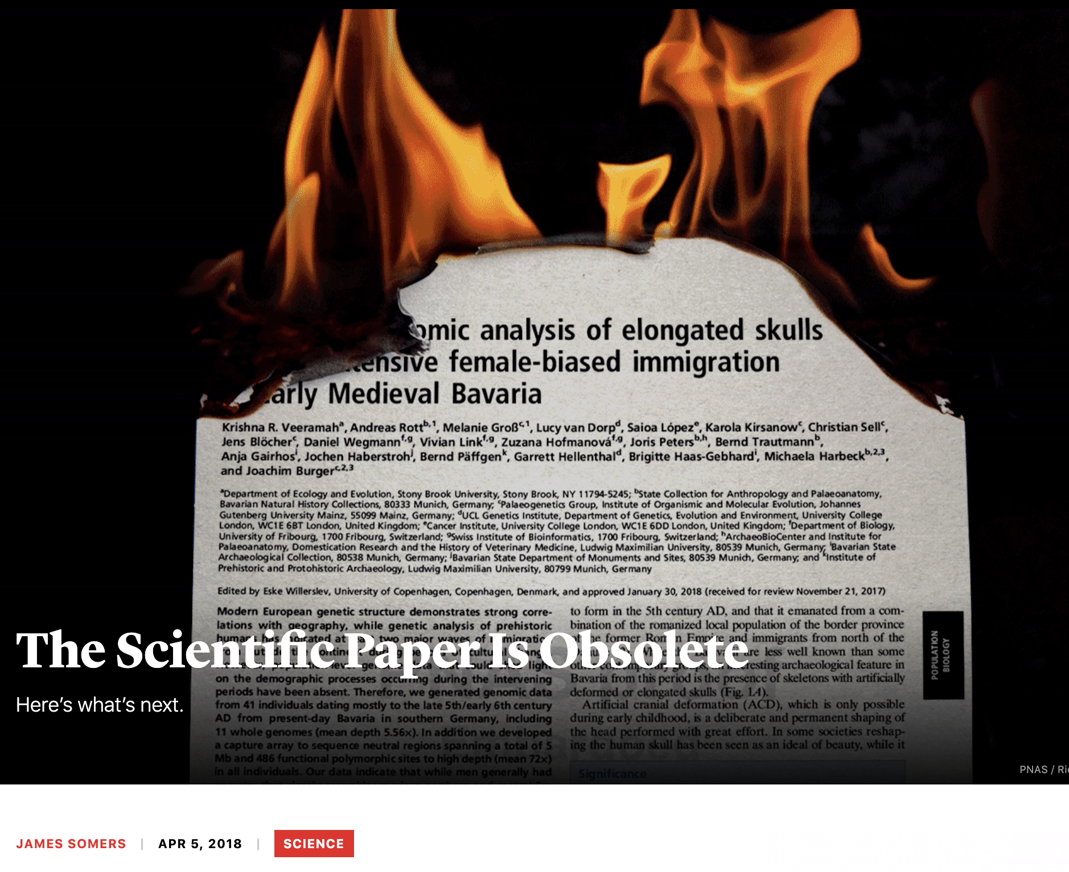

Slide 16
Questions PDFs don’t answer
What does the raw data actually look like?
How exactly was this analysis performed?
How sensitive is this result to the specific parameters of the analysis?
Exactly what datapoints went into this statistical test?
How can I run this analysis on a different dataset?
How can I run this analysis 5 years from now?

Slide 17
Reproducible pipelines
Analysis 1
Plot 1
Final manuscript
Analysis 2
Plot 2
Data
Manuscript text
Where the actual science happens
What we usually share

Slide 18
An article about computational science in a scientific publication is not the scholarship itself, it is merely advertising of the scholarship. The actual scholarship is the complete software development environment and the complete set of instructions which generated the figures.
-- Buckheit and Donoho
WaveLab and Reproducible Research, 1995

Slide 19
challenges
How to mix analysis and text?
How to make plotting automated and effective?
How to verify these analyses?
How to specify and execute this analysis graph?
How to share this whole pipeline in a simple way?

Slide 20
Incentives
Why should we share anything besides the final manuscript?
What if we made a mistake and someone finds it, and we have to retract the paper?
What if this makes it easier for other people to scoop our future work?
Why spend the time to clean up and document data/analyses?
Incentives to share:
Scientific ethics and community norms
Funding agency requirements (e.g. NIH mandates data sharing)
Advantages for your future self!
Journal requirements?

Slide 21
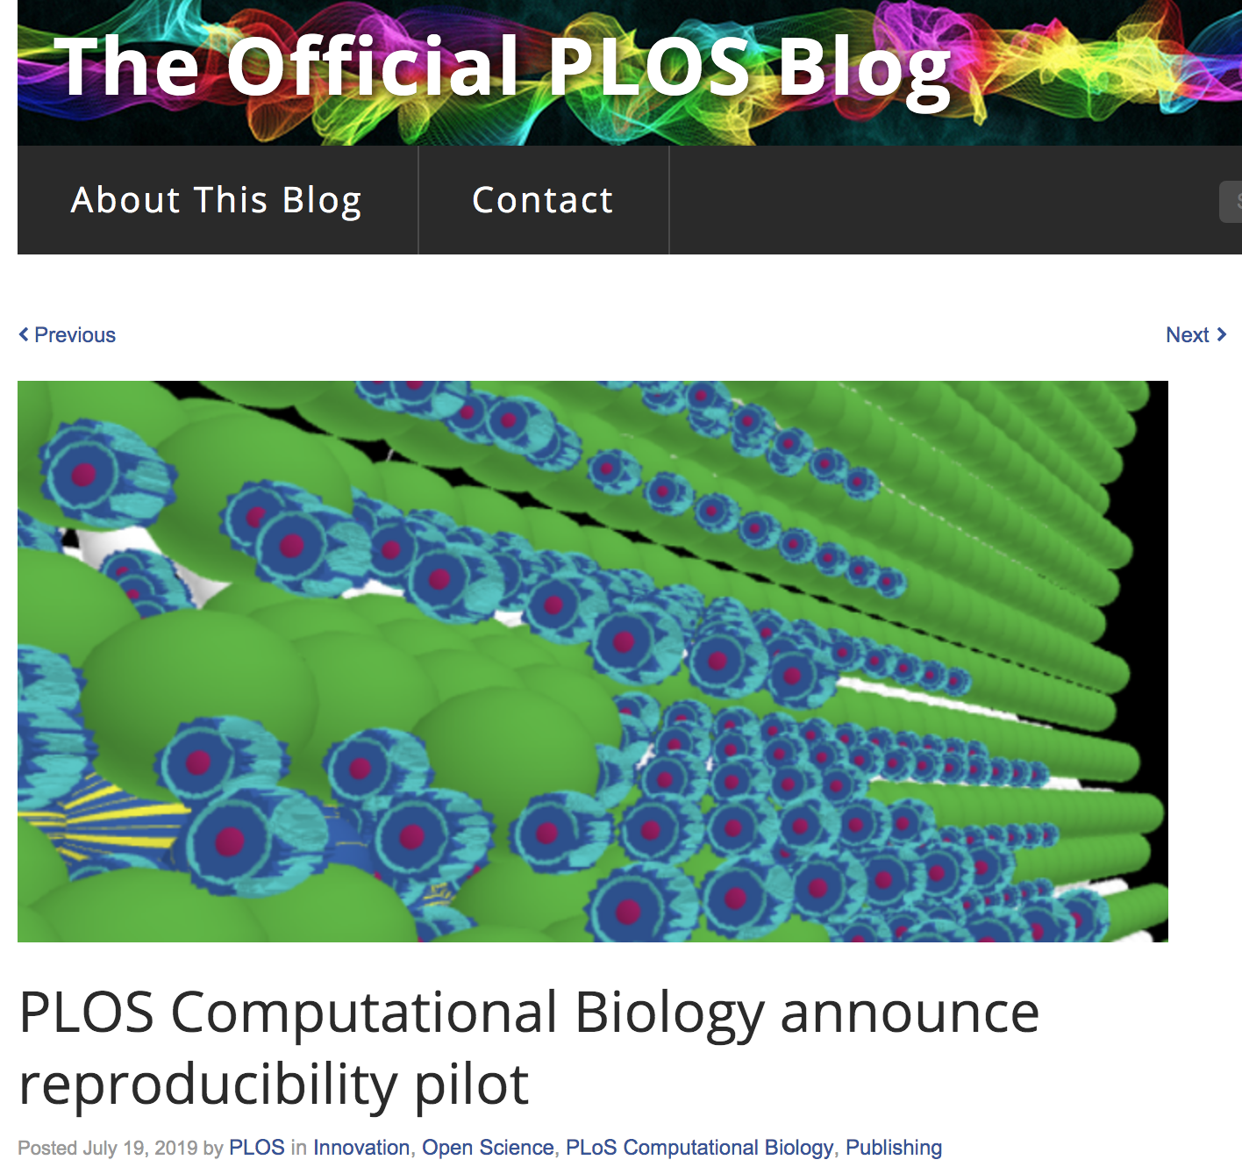

Slide 22
9/13/19 – Notebooks
Increasingly popular tool for:
Interacting with and visualizing data
Combining text and code in the same file
Sharing analyses with text explanations

Slide 23
9/20/19 – Version Control
Version control software (e.g. git) allow us to keep track of changes we are making to our analyses, and work efficiently with multiple people
Allows us to push our local work to public repositories for sharing

Slide 24
9/27/19 – Reproducible plots in R

Slide 25
10/4/19 – Reproducible plots in python

Slide 26
10/11/19 – Text Editors and IDES
Notebooks may not be enough for complex projects
Integrated development environments (IDEs) provide tools for avoiding syntax errors, and allow for line-by-line debugging of analysis logic

Slide 27
10/18/19 – Reproducible Reports
Tools such as Rmarkdown and Pweave can produce static documents (e.g. pdfs) from an input file with text and code
For relatively simple reports, this provides an easy way to specify a reproducible analysis

Slide 28
10/25/19 – Reproducible Manuscripts
More complicated projects may involve multiple long-running analyses and software other than python or R (e.g. fMRI preprocessing)
Tools such as make can describe directed graphs of analyses, and rebuild only the necessary portions when we make a change

Slide 29
11/1/19 – Simulation
Can verify pipelines by injecting simulated data, and testing that:
When an effect is present in the simulated data, it is correctly detected
When an effect is not present in the simulated data, it is correctly rejected
Packages for generating realistic fMRI data

Slide 30
11/8/19 – Testing
Although very common in the software engineering world, research software rarely includes a suite of explicit test functions
Regression testing can alert us whenever a new change we’ve made to an analysis has broken a previous result

Slide 31
11/15/19 – reproducible containers
Sharing code is not enough for full reproducibility
Also need to share the computational environment we used:
Which version of python/R
Which packages and which versions of those packages
Which OS
Containers such as docker combine code with a platform for executing it, which (in theory) can be run in the same way at any future time

Slide 32
11/22/19 – Sharing Pipelines
Finally, we need ways to publicly share our pipelines, ideally in ways that allow anyone to reproduce our analyses right in the browser
This was unheard-of a few years ago, but multiple new platforms have started to make this relatively easy
This class will be a guest presentation by CodeOcean

Slide 33
12/6/19 – Final project presentations
Everyone will give a short (10-minute) presentation on their projects, describing both the scientific and technical aspects
Presentations will be graded based on:
coverage of the necessary scientific background
description of the goals of the analysis
explanation of the technical design decisions made in the project
clarity of the presentation of the final results

Slide 34
TODAY: Set up Some Software
Follow setup instructions on https://happygitwithr.com
Chapter 4: Register a GitHub account
Email c.baldassano@columbia.edu with your GitHub account name
Chapter 5: Install or upgrade R and Rstudio
Chapter 6 and 7: Install and configure Git
Install Anaconda python 3.7 from https://www.anaconda.com/
Includes both Anaconda Navigator GUI and command-line tools
Install PyCharm community edition from https://www.jetbrains.com/pycharm/

